Slide 1

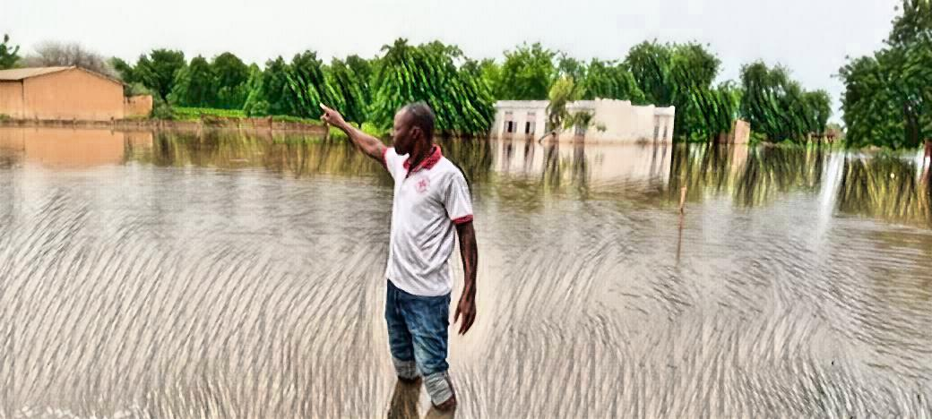
Mali and the Quest for the Validated EAP

Slide 2

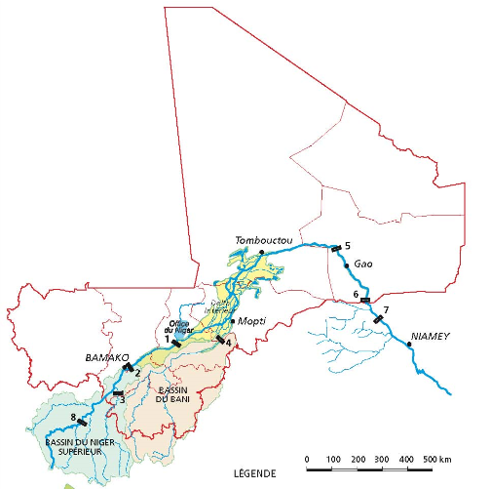

Slide 3
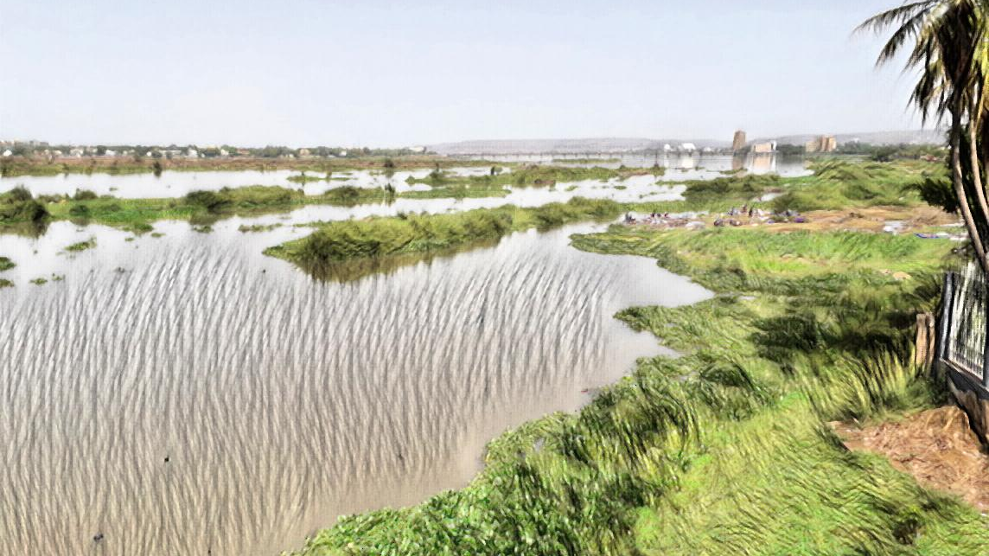
ON THE SHORE OF THE NIGER RIVER IN BAMAKO, EVERYTHING IS CALM AND PEACEFUL, HERE A FEW WEEKS BEFORE THE RAINY SEASON IS ABOUT TO START…
… BUT…

Slide 4
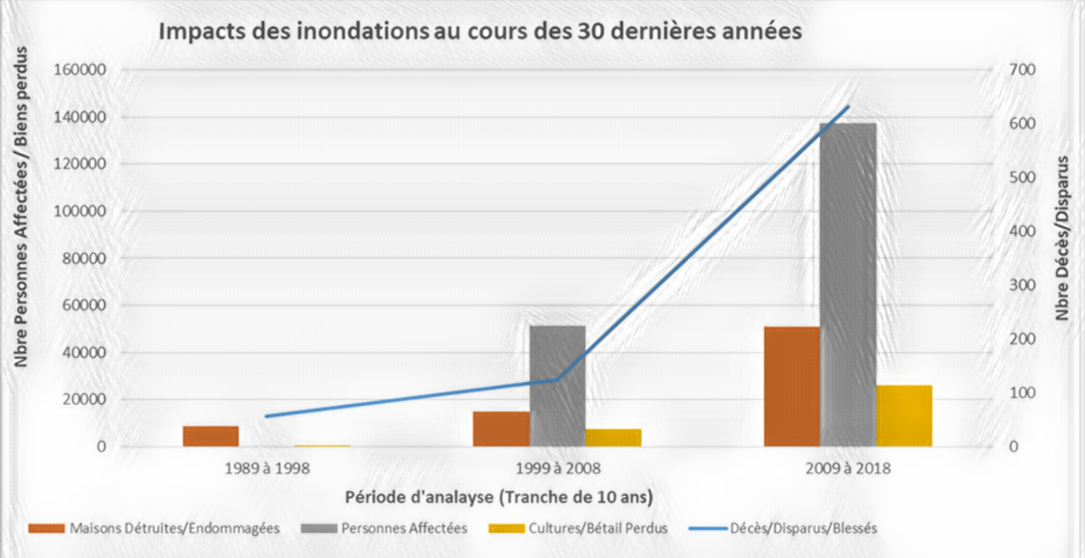
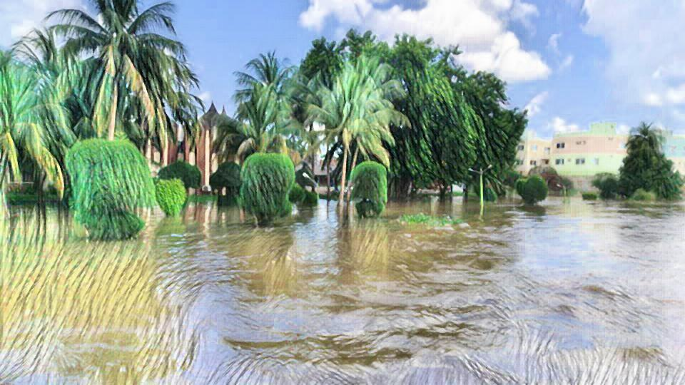
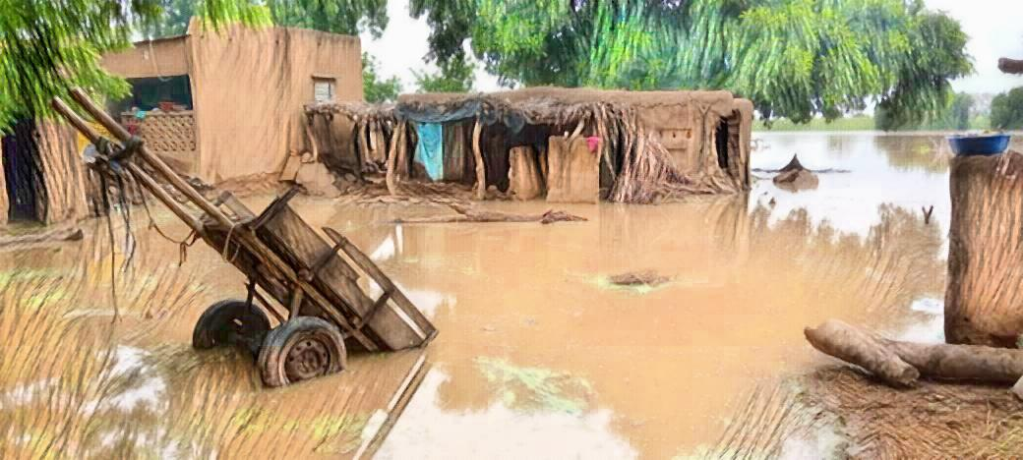
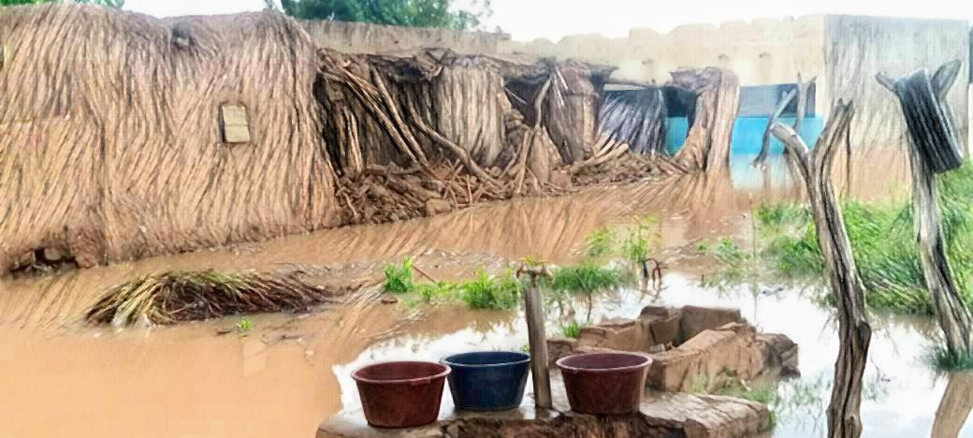
… IN THE LAST FEW DECADES, THE IMPACTS OF FLOODING HAS DRAMATICALLY INCREASED.

Slide 5
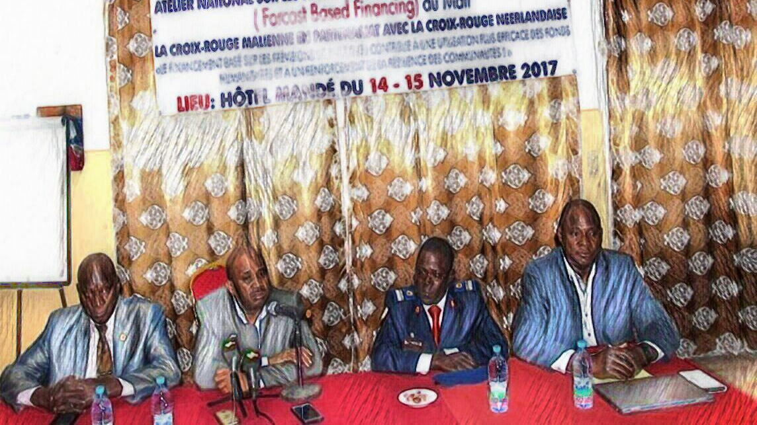
SO IN 2017, MALI RED CROSS (MRC) TOOK THE INITIATIVE TO HOST A NATIONAL DIALOGUE PLATFORM ON FBF. THE OBJECTIVE WAS TO DISCUSS IF FBF COULD BE PART OF THE SOLUTION TO THIS PROBLEM.
We welcome, all 60 participants from the UN, Government, Red Cross and NGOs

Slide 6
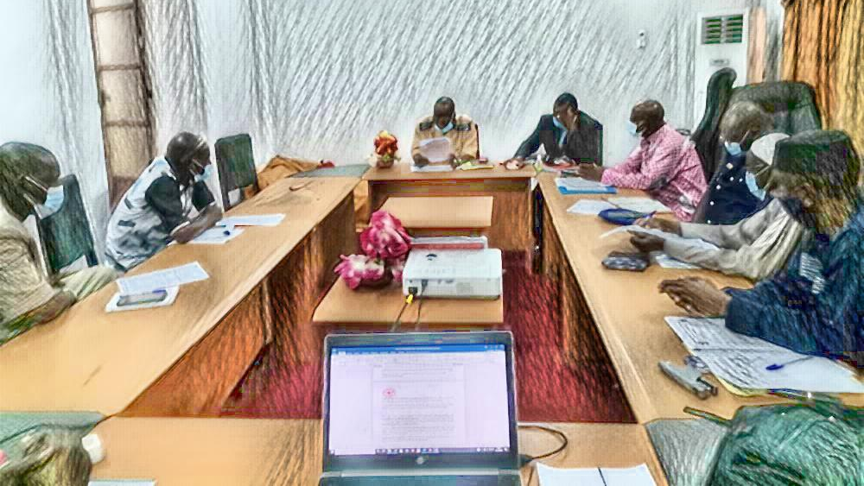
THE DIALOGUE PLATFORM RESULTED IN MALI RC BEING SELECTED AS LEAD ON ANTICIPATORY ACTIONS IN MALI. A TECHNICAL WORKING GROUP WAS ESTABLISHED WITH PARTICIPATION BY...
Civil Protection
National Direction of Hydraulics
Mali Météo
Health Department
The National Early Warning Centre
Mali Red Cross
Social Development

Slide 7
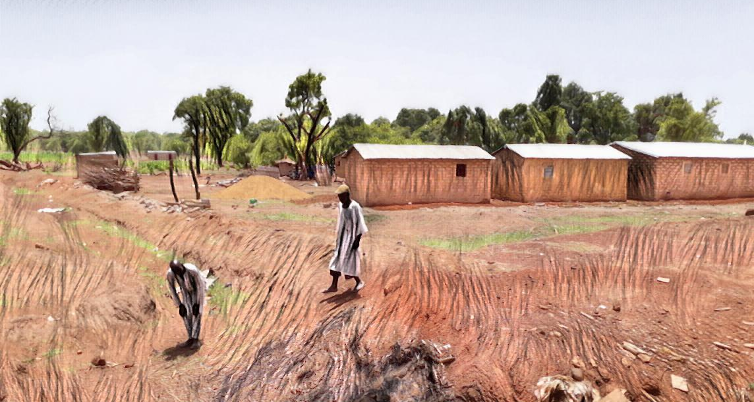
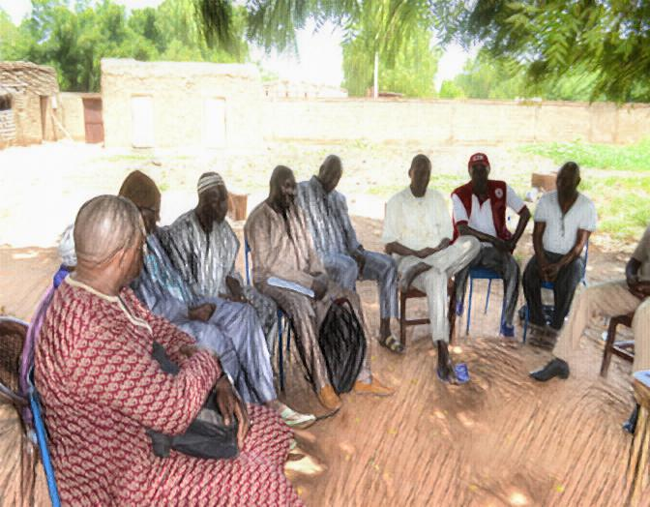
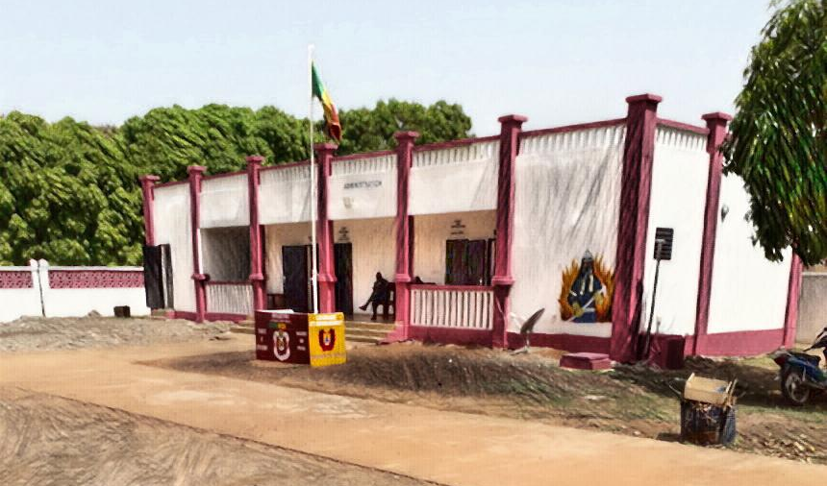
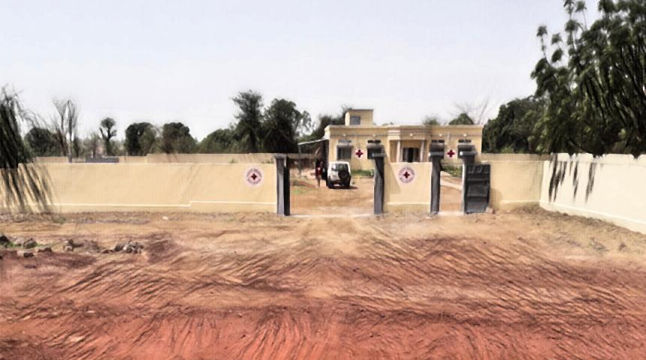
TO GET A BETTER UNDERSTANDING OF THE SITUATION, THE RC FBF TEAM WENT TO VISIT SOME OF THE IMPACTED AREAS TO GET THE PERSPECTIVE OF…
…THE COMMUNITIES…
…REGIONAL RC BRANCHES AND…
…REGIONAL TECHNICAL SERVICES.

Slide 8
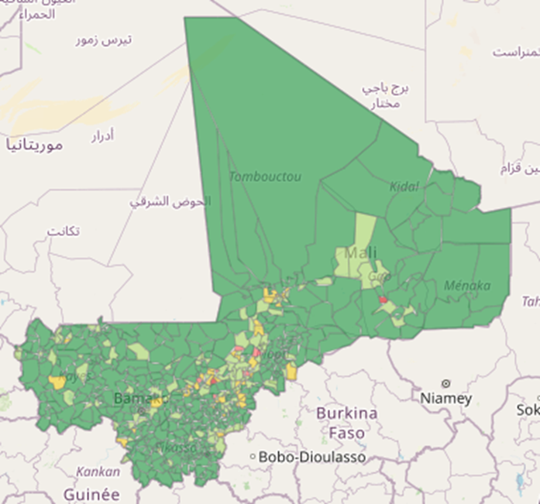
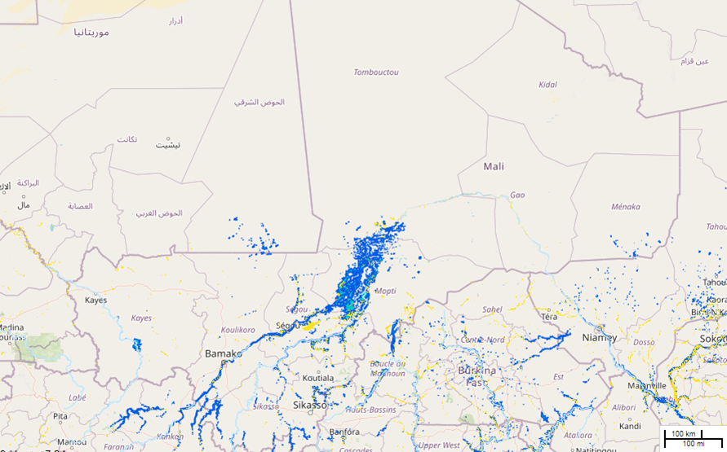
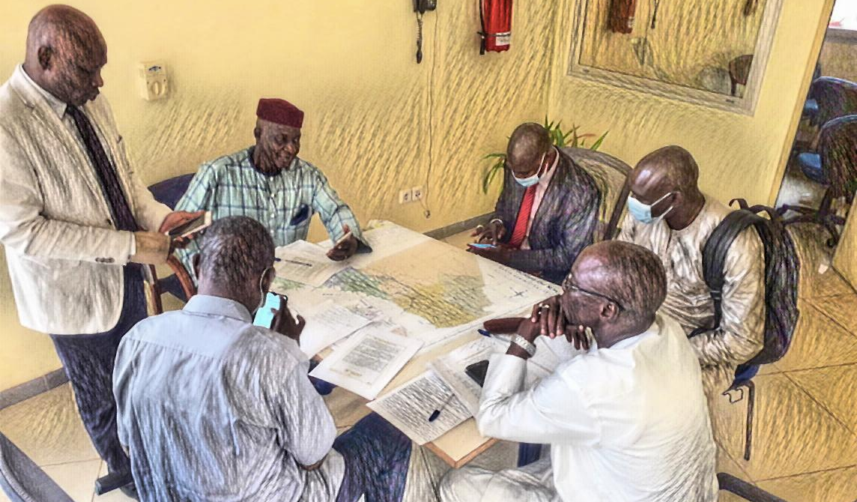
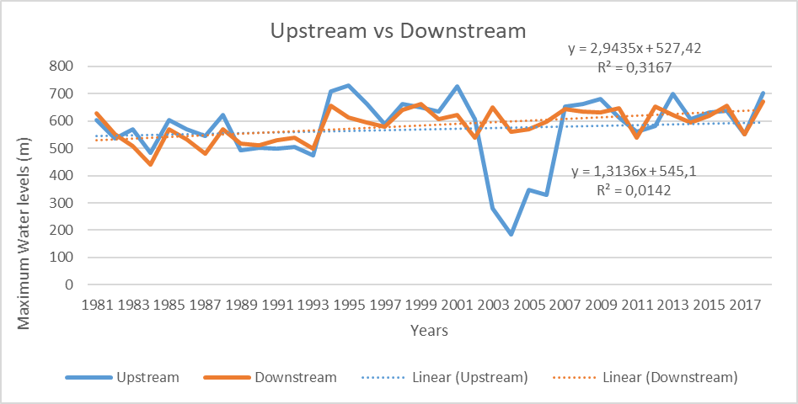
THE FBF TEAM ALSO GOT TECHNICAL SUPPORT FROM 510 AND THE CLIMATE CENTRE.
WITH ALL THESE INFORMATIONS, MORE MEETINGS AND DISCUSSIONS ENSUED.

Slide 9
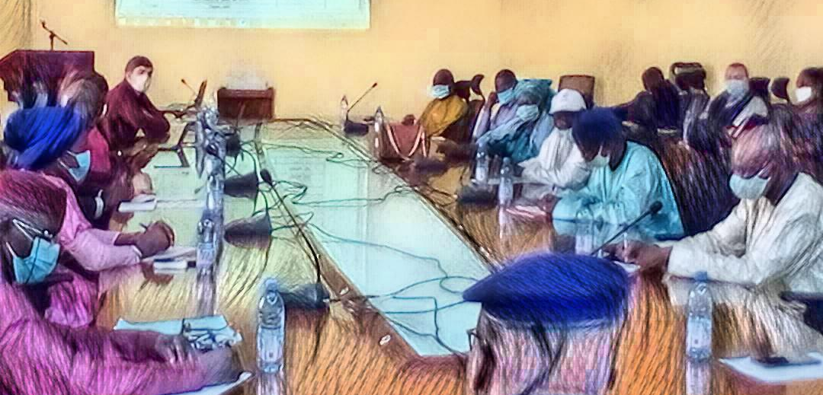
THE DEVELOPING OF THE TRIGGER THEN BEGAN…
Yes, of course!
$$$
Could we get access to the meteorological data for the past 30 years?

Slide 10




THE TRIGGER WAS FINALLY DEVELOPED BASED ON RIVER LEVELS…
… PROVIDING A LEAD TIME OF 4 DAYS.
… AND IS MEASURED TWICE DAILY BY THE DIRECTION OF HYDRAULICS…

Slide 11
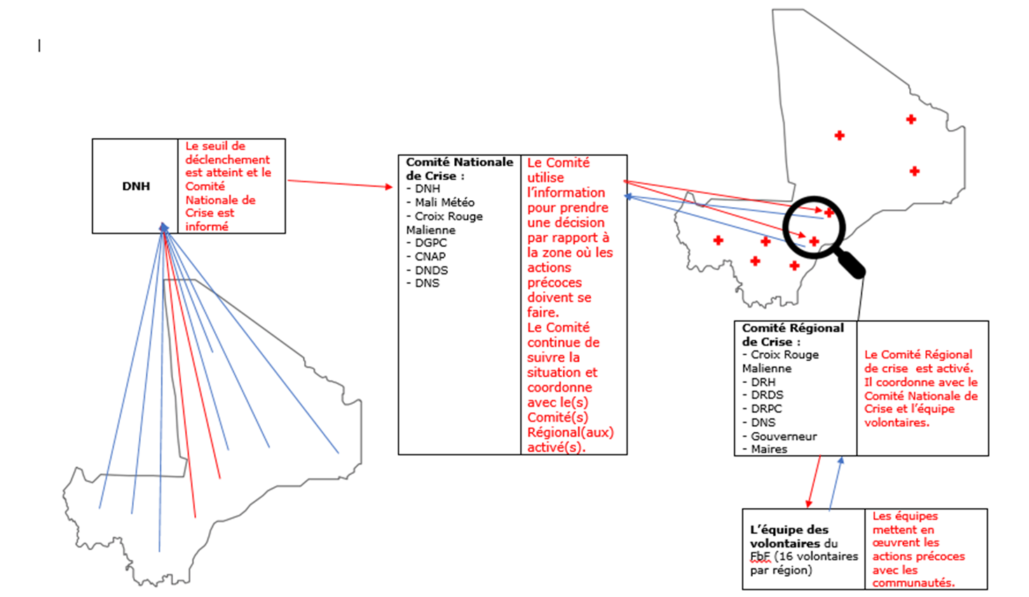

Slide 12
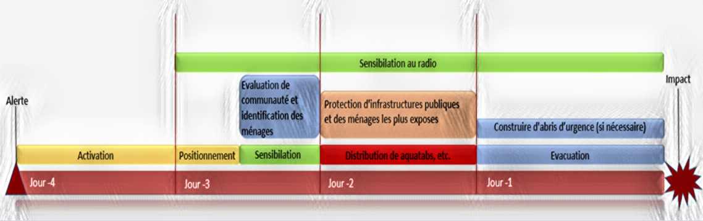
A TIMELINE FOR THE EARLY ACTIONS WAS THEN DEVELOPED.
BUT IT IS NOT ENOUGH TO JUST HAVE A LOT OF NICE FIGURES AND FANCY WORDS ON PAPER. SO THE TEAM SIMULTANEOUSLY ALSO STARTED DEVELOPING THE CAPACITY OF MRC AND ITS PARTNERS. THIS HAPPENED THROUGH…

Slide 13
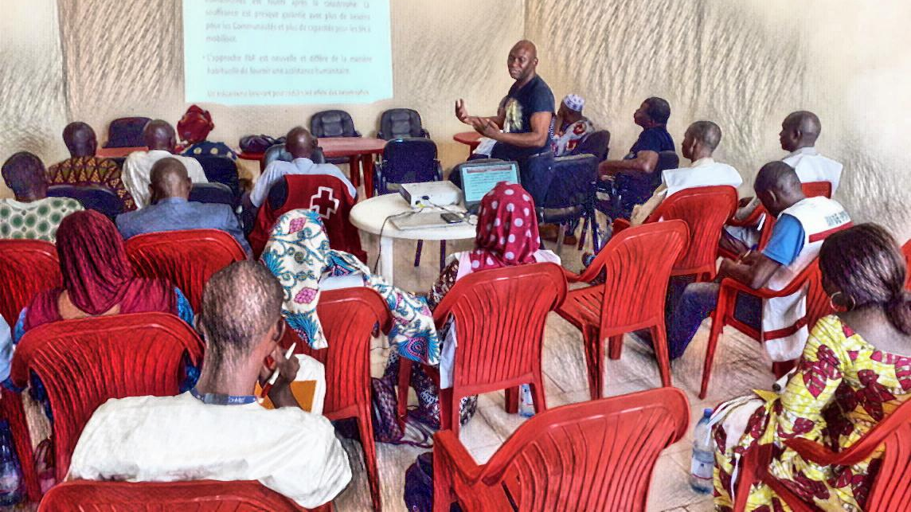
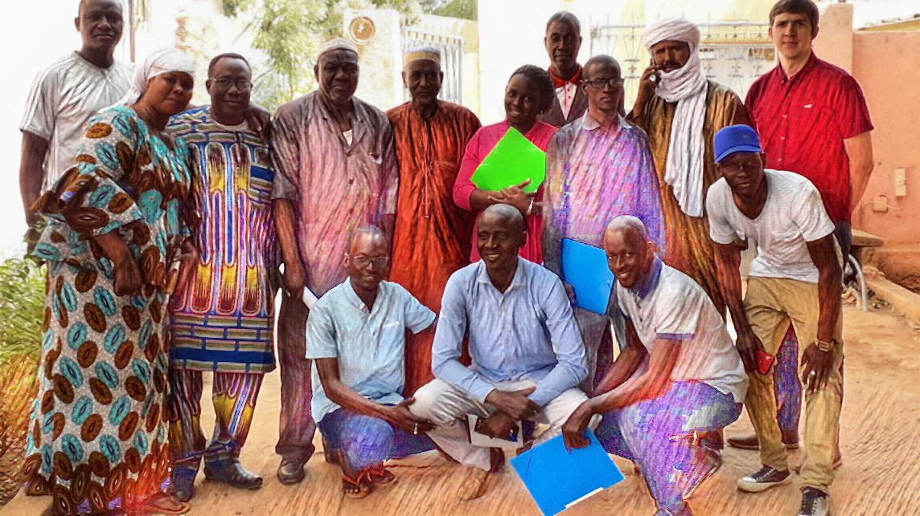
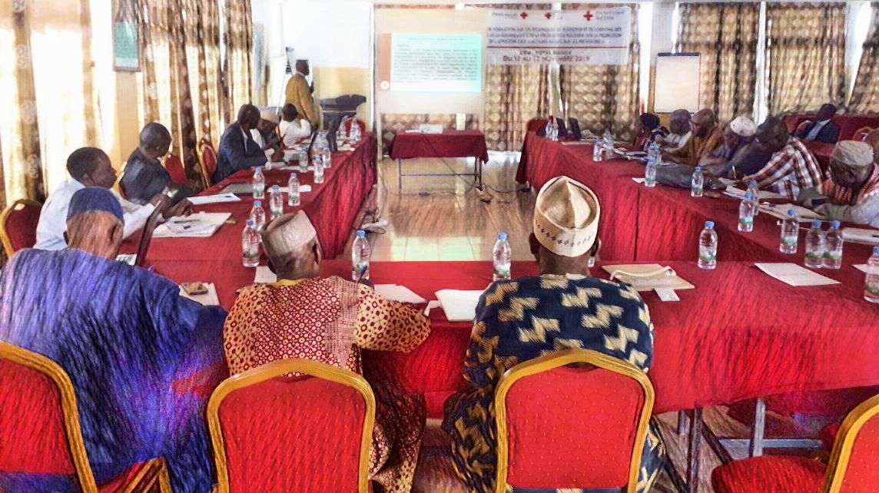
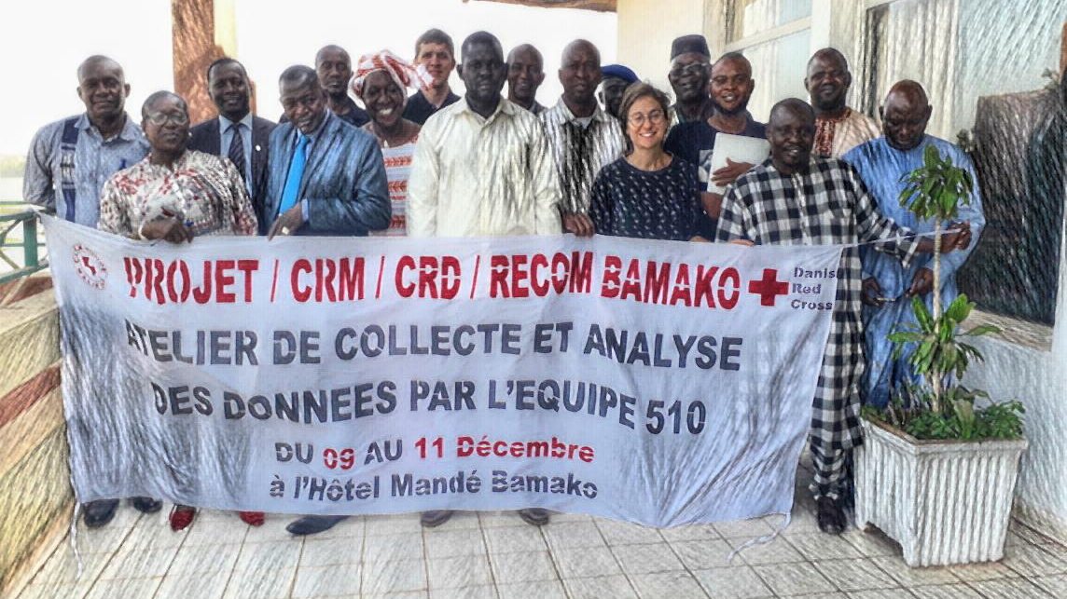
… VOLUNTEER TEAMS…
… REGIONAL FBF FOCAL POINTS…
… LOBBYING AND ADVOCACY…
… DATA COLLECTION AND ANALYSIS.

Slide 14
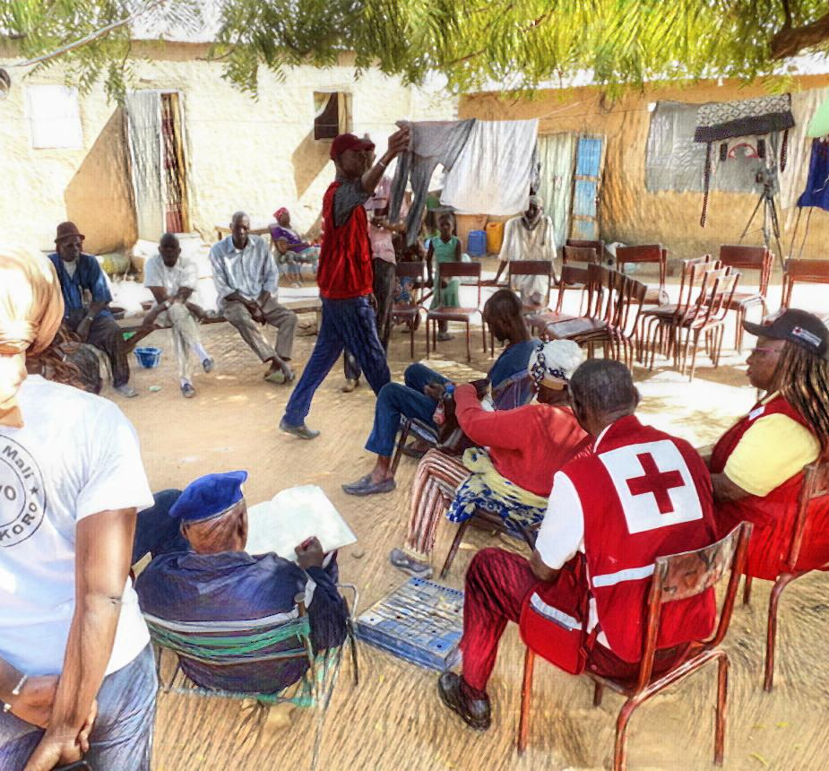
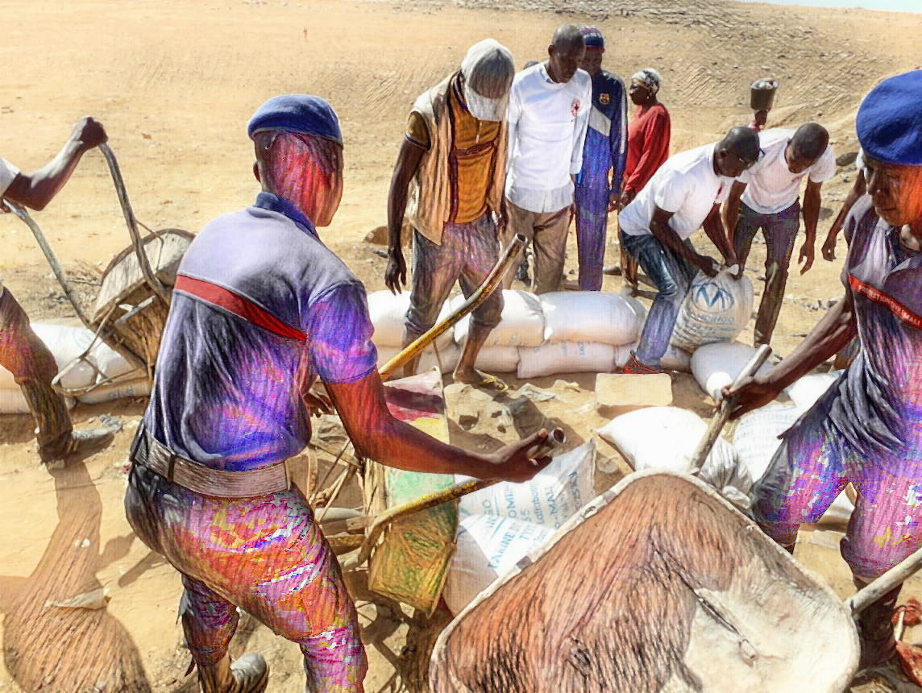
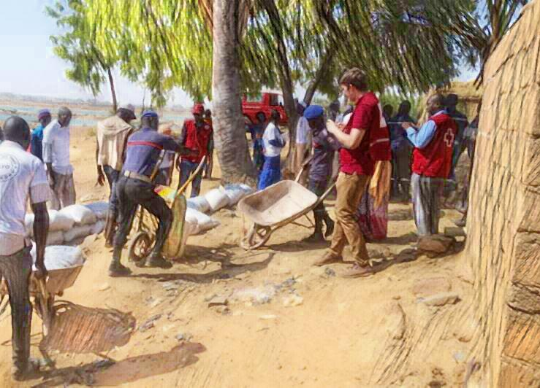
BESIDES TRAININGS, 2 DRY TESTS WERE ALSO CARRIED OUT TO TEST THE CAPACITY IN PRACTICE…

Slide 15
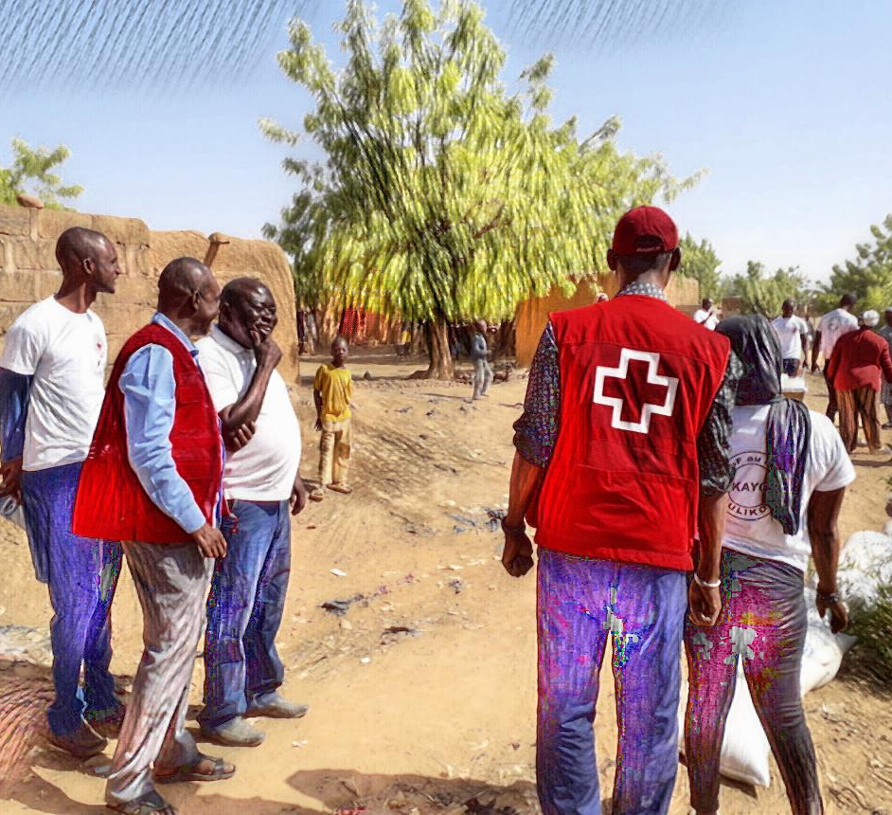
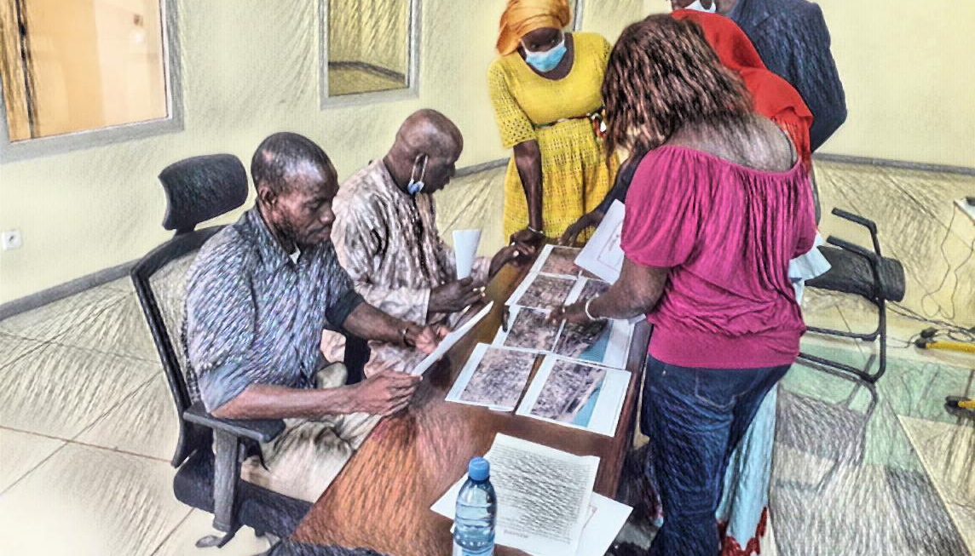
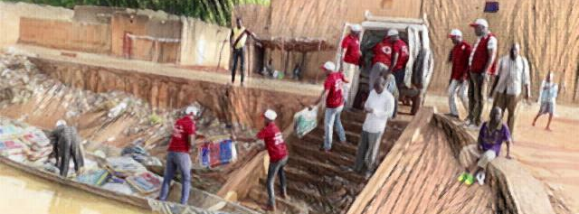
… AS WELL AS TABLETOP EXERCISES WITH THE CRISIS COMMITTEES.
There is no way we will be able to do all that within 4 days.
SOME PLACES ARE MORE ACCESSIBLE THAN OTHERS.

Slide 16
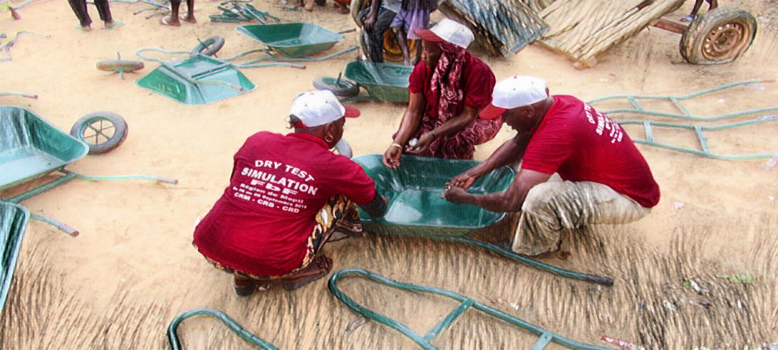
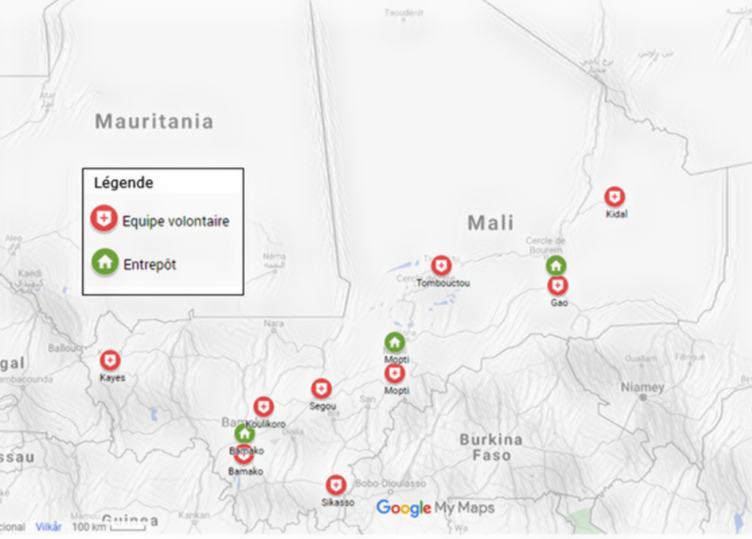
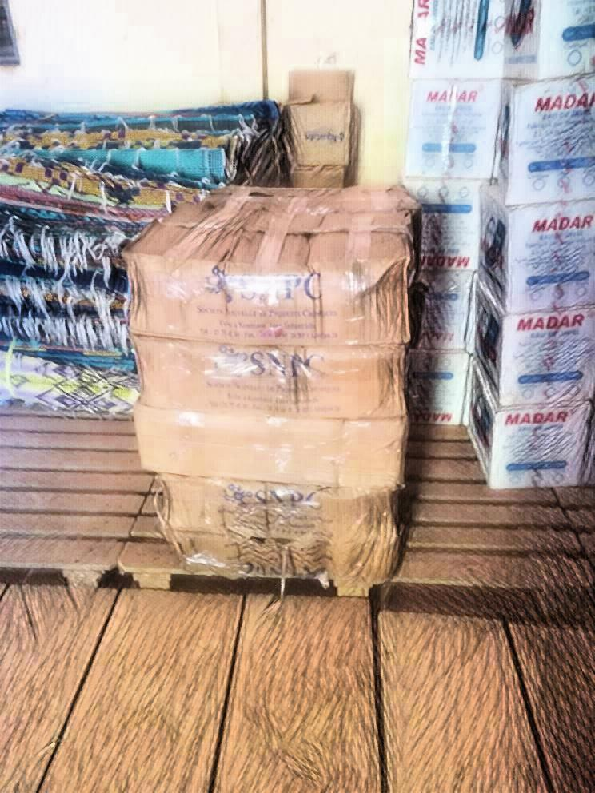
IN EVERY REGIONAL CAPITAL IN MALI THERE IS NOW A TRAINED VOLUNTEER TEAM, AN FBF FOCAL POINT AND A REGIONAL CRISIS COMMITTEE.

Slide 17
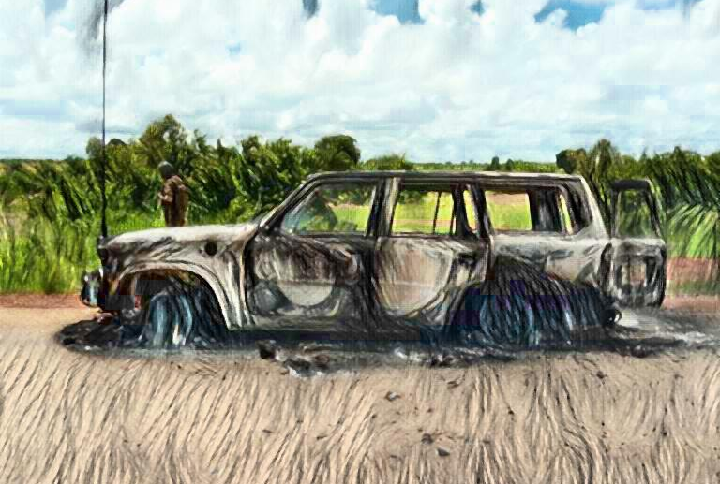
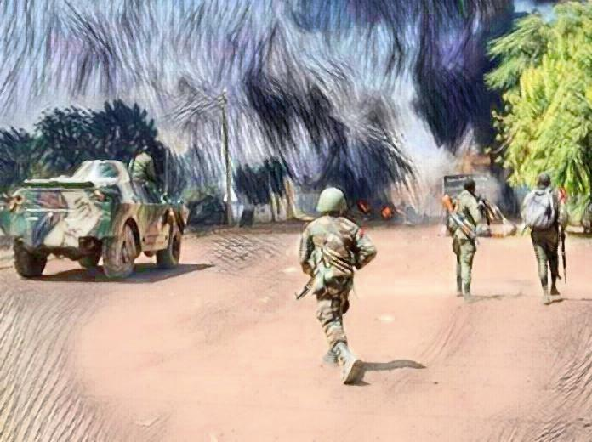
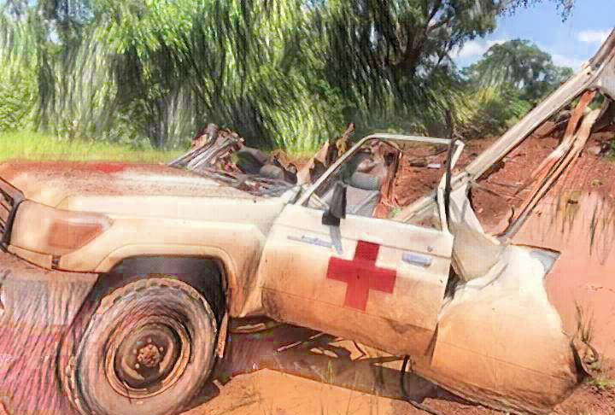
DUE TO THE SITUATION IN MALI, THERE IS HOWEVER ALSO OTHER FACTORS THAT NEED TO BE TAKEN INTO ACCOUNT.

Slide 18
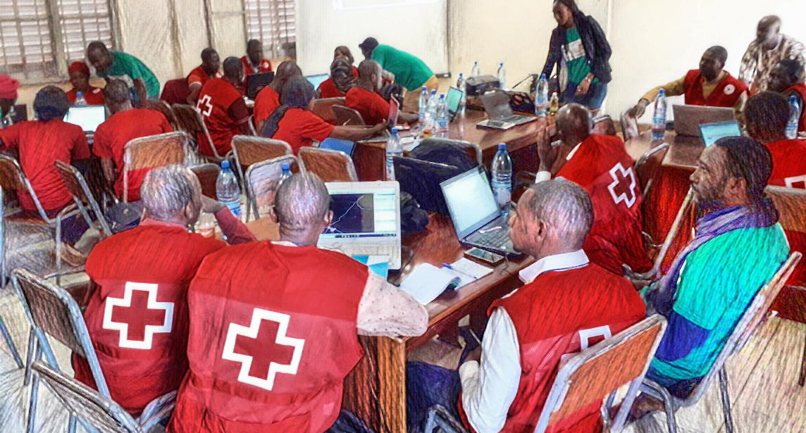
SOME CHALLENGES COME FROM INSIDE.
According to our project we should do this instead!
That is not how we see it.
We should do it like this!
But we have funding for this other activity that must be done this month.
???

Slide 19

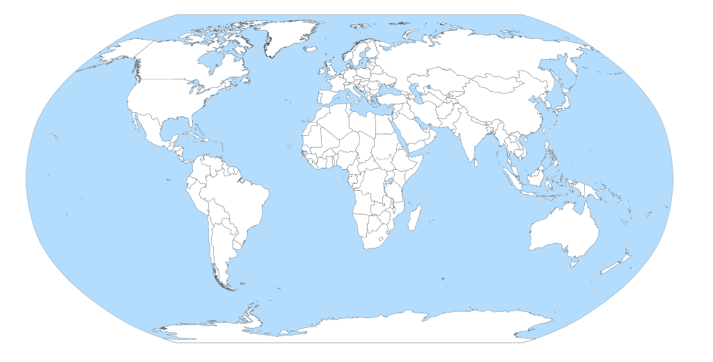


THE EAP DOCUMENT IS FINALLY DONE AND SUBMITTED FOR VALIDATION.

Slide 20
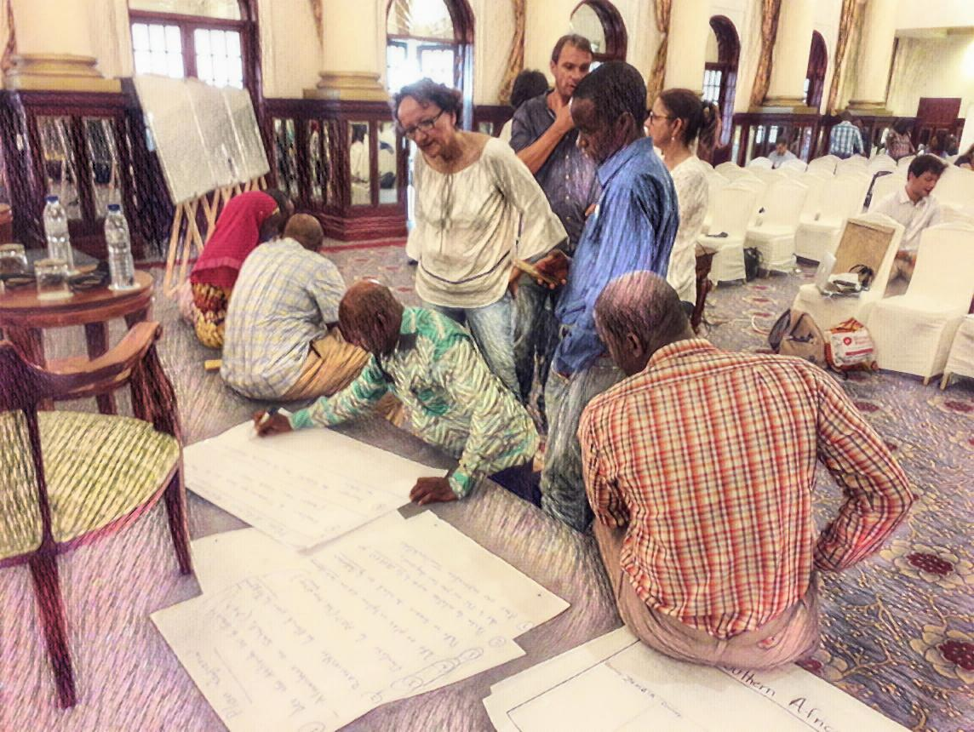
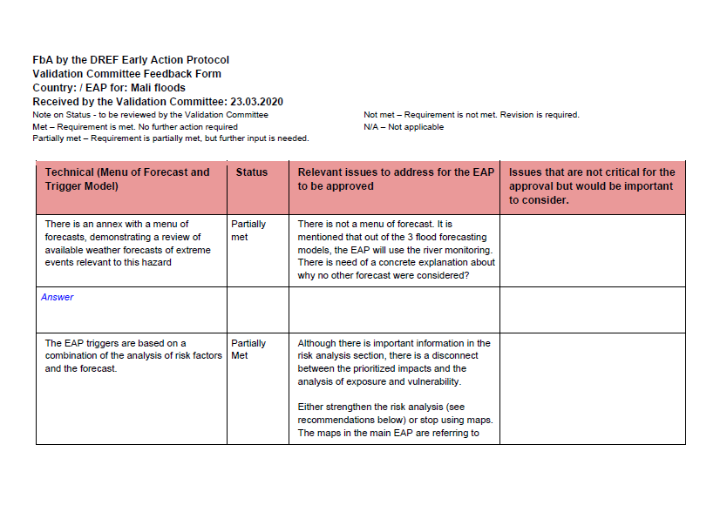

WITHIN 3 WEEKS, THE VALIDATION COMMITTEE PROVIDED THEIR FEEDBACK…
… AND THEN IT WAS BACK TO DRAWING BOARD.

Slide 21
AFTER REVISION THE TEAM SUBMITTED AGAIN…

Slide 22
… AND AGAIN…

Slide 23
… AND AGAIN…

Slide 24




WITH THE EAP APPROVED BY IFRC, MALI RED CROSS RECEIVES FUNDING THROUGH ‘FBA BY THE DREF’ FOR A 5-YEAR PERIOD.
THE FUNDS ARE TO COVER READINESS COSTS, PREPOSITIONING AND TRIGGERING.
IN MALI, THE FUNDS WILL COVER…

Slide 25
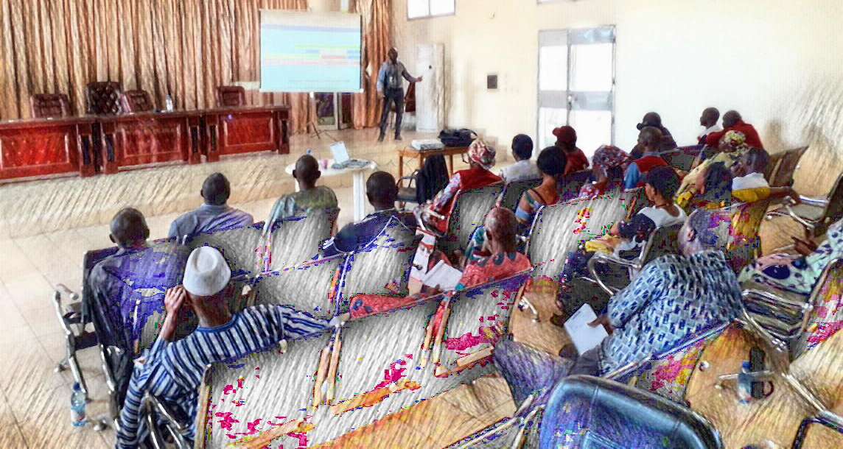
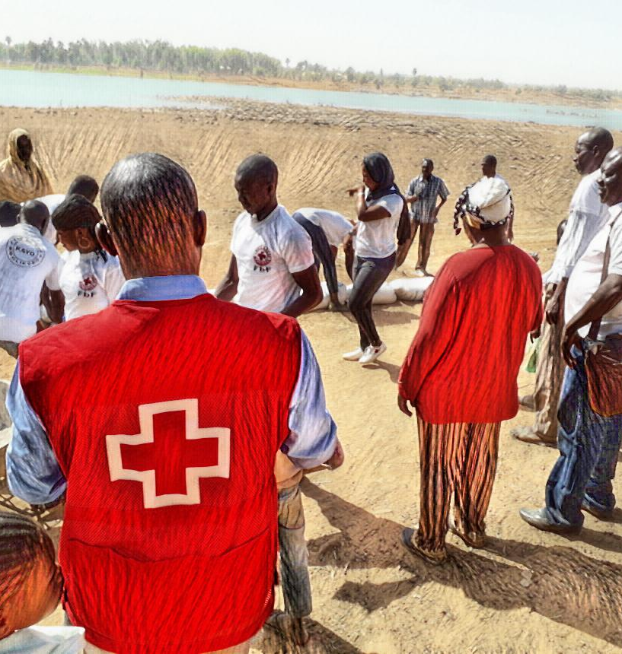
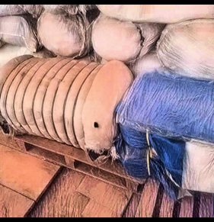
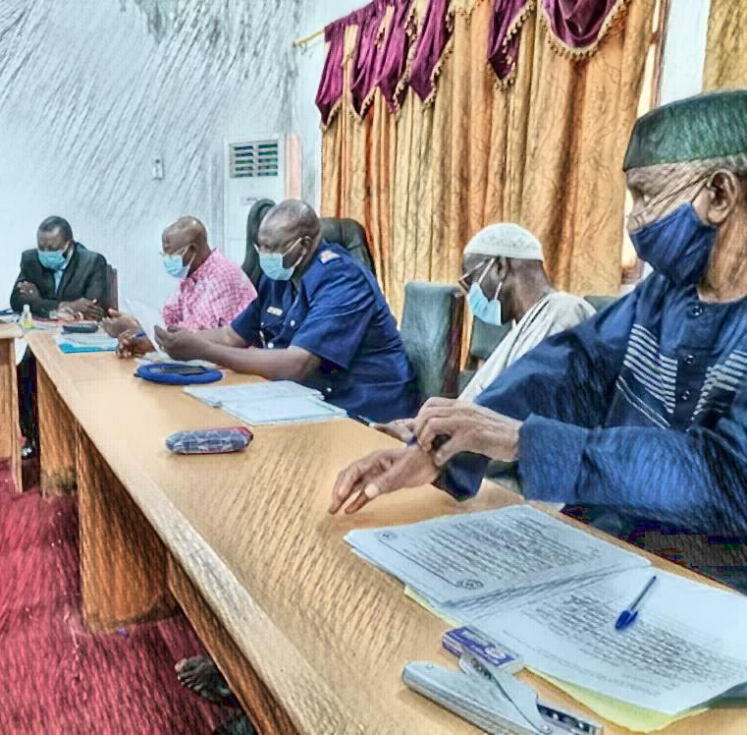
… AND ONE TRIGGERING OF EARLY ACTIONS.
… REFRESHER TRAININGS OF THE VOLUNTEERS…
25 % of my annual salary is also covered for the next 5 years.
… BI-MONTHLY MEETINGS WITH THE TECHNICAL SERVICES…
… PREPOSITIONING…

Slide 26
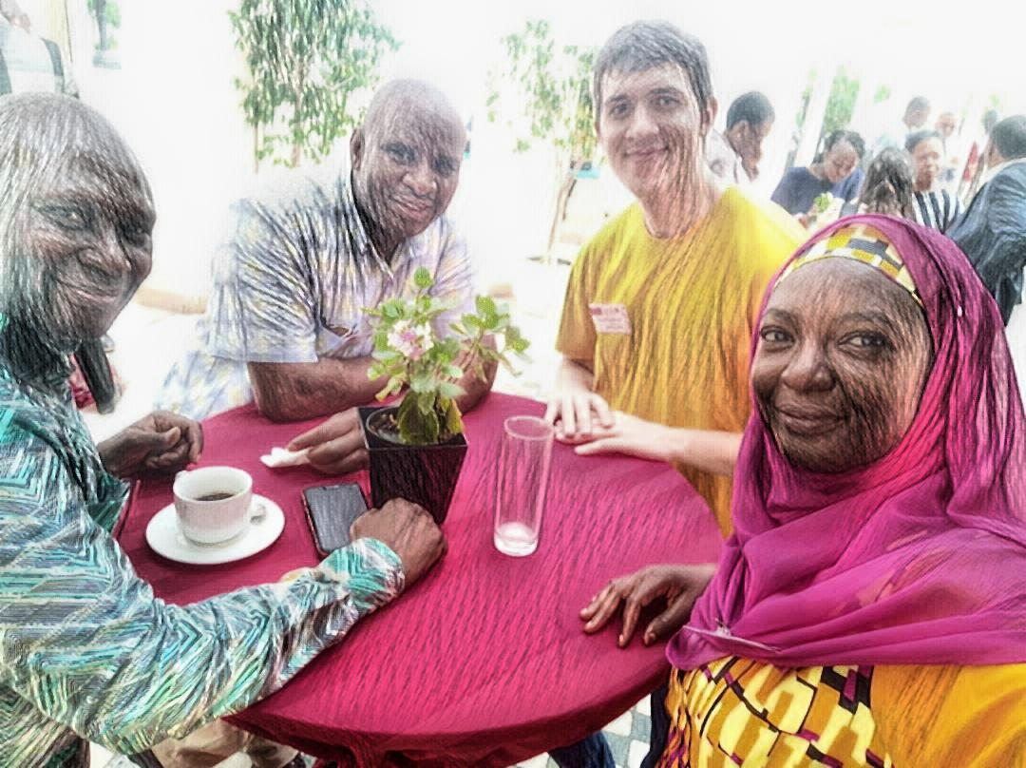


OVER THE 5-YEAR PERIOD MALI RC RECEIVES:
58.700 CHF FOR READINESS COSTS
55.000 CHF FOR PREPOSITIONING
59.000 CHF FOR EARLY ACTIONS (IF TRIGGERED)
AND THEY LIVE HAPPILY UNTIL THEIR TRIGGER IS MET…

